Slide 1
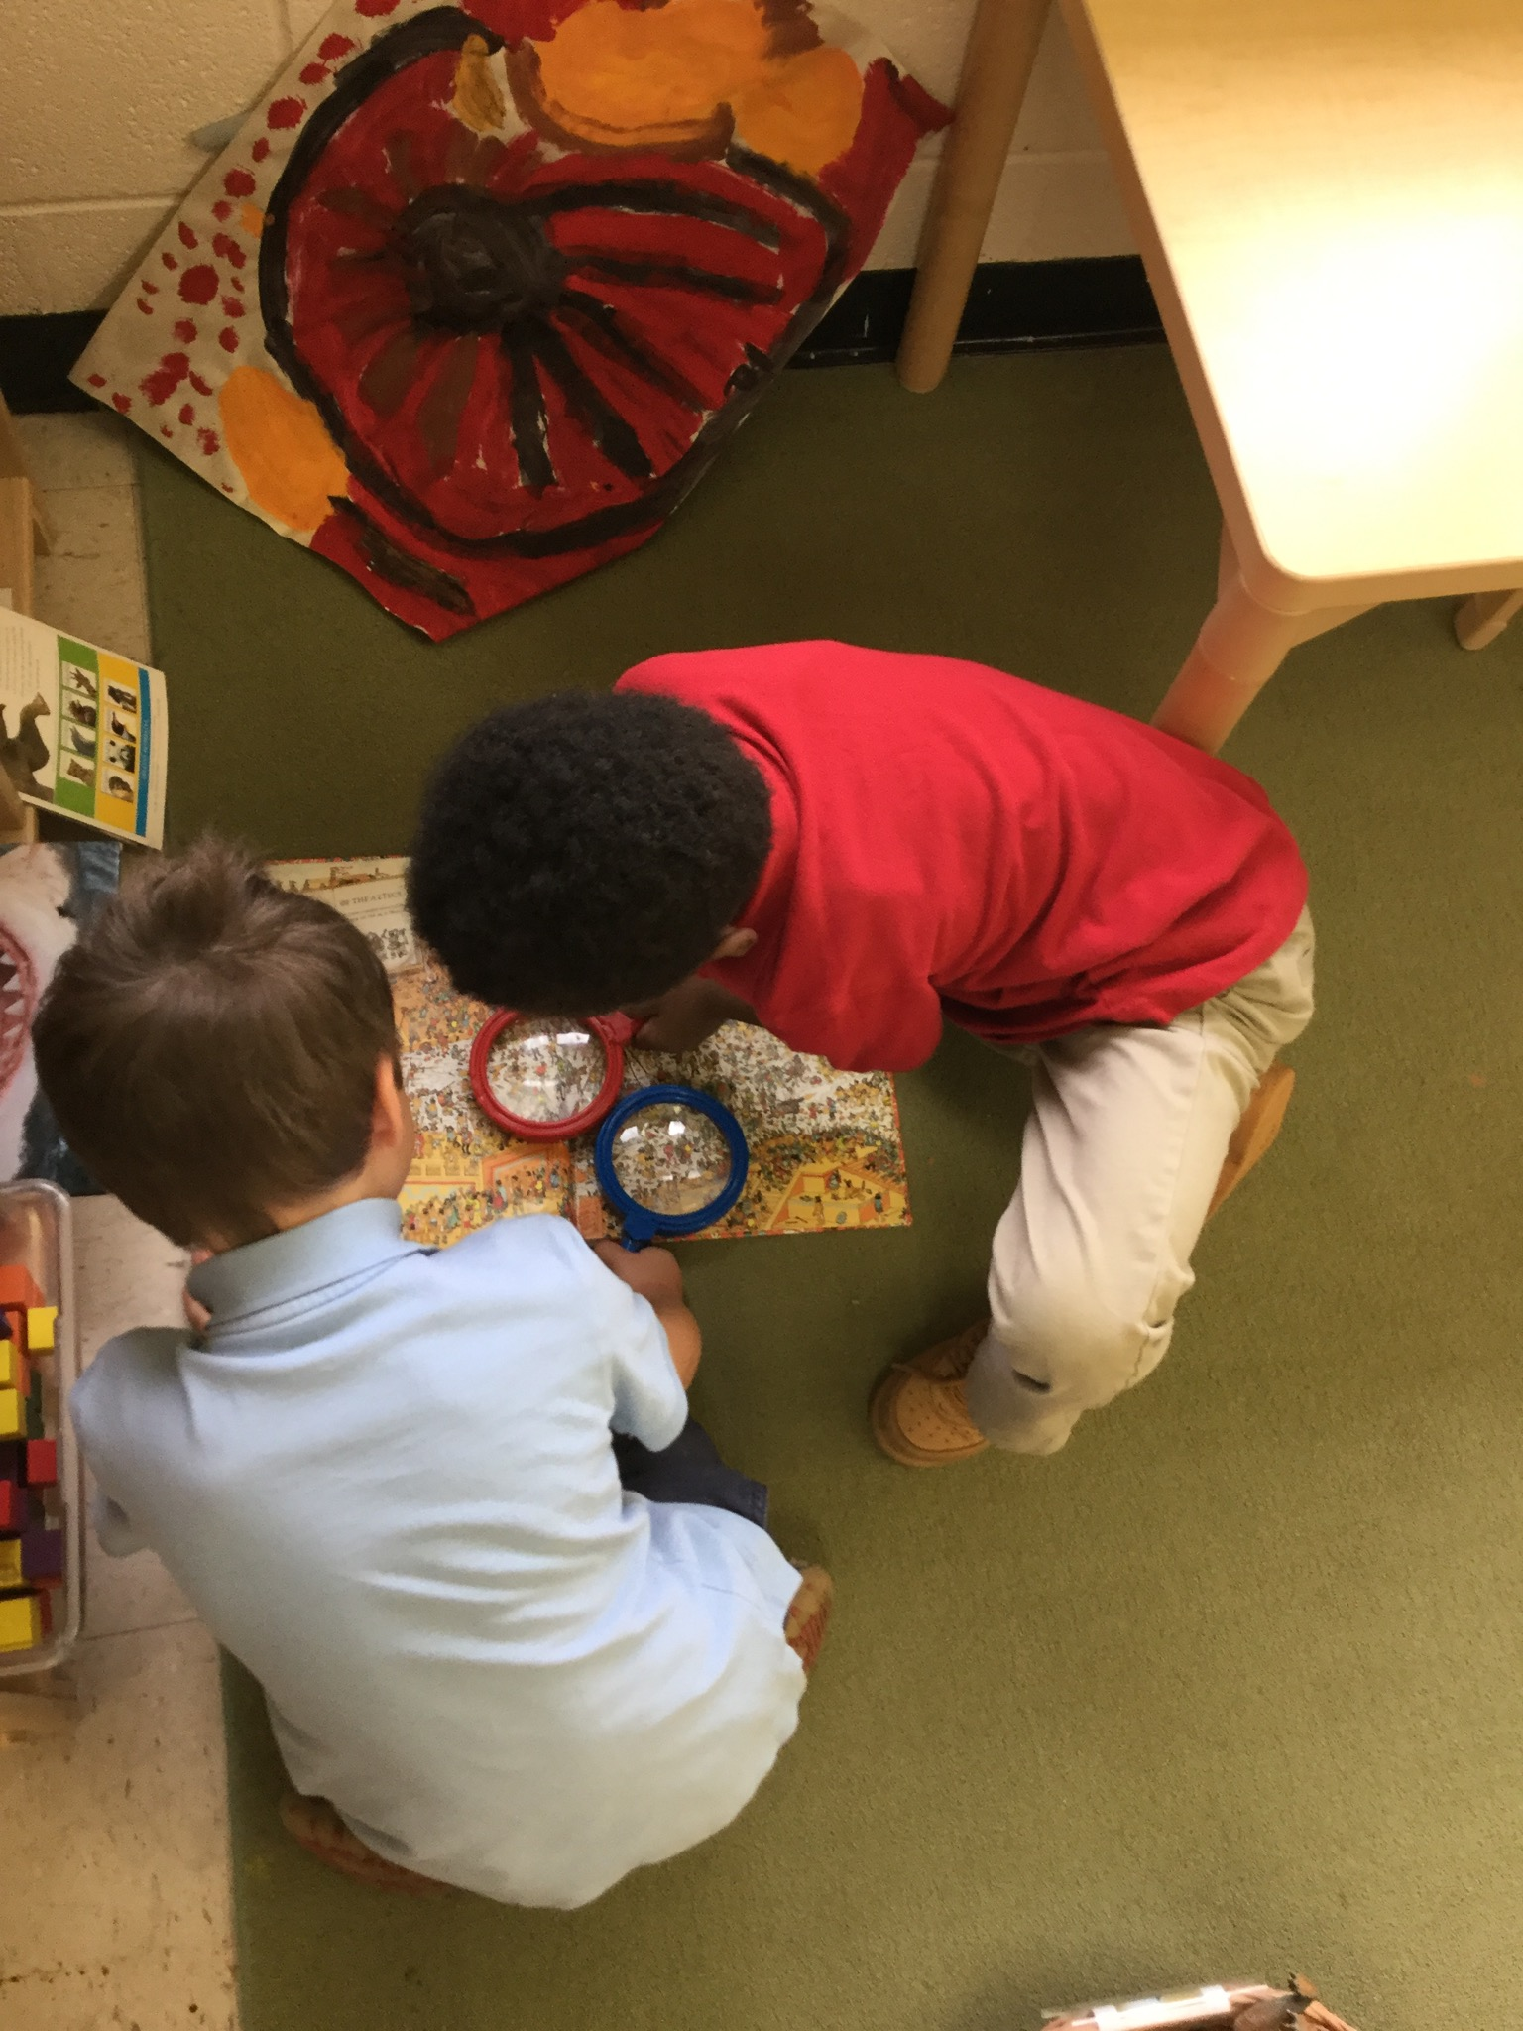
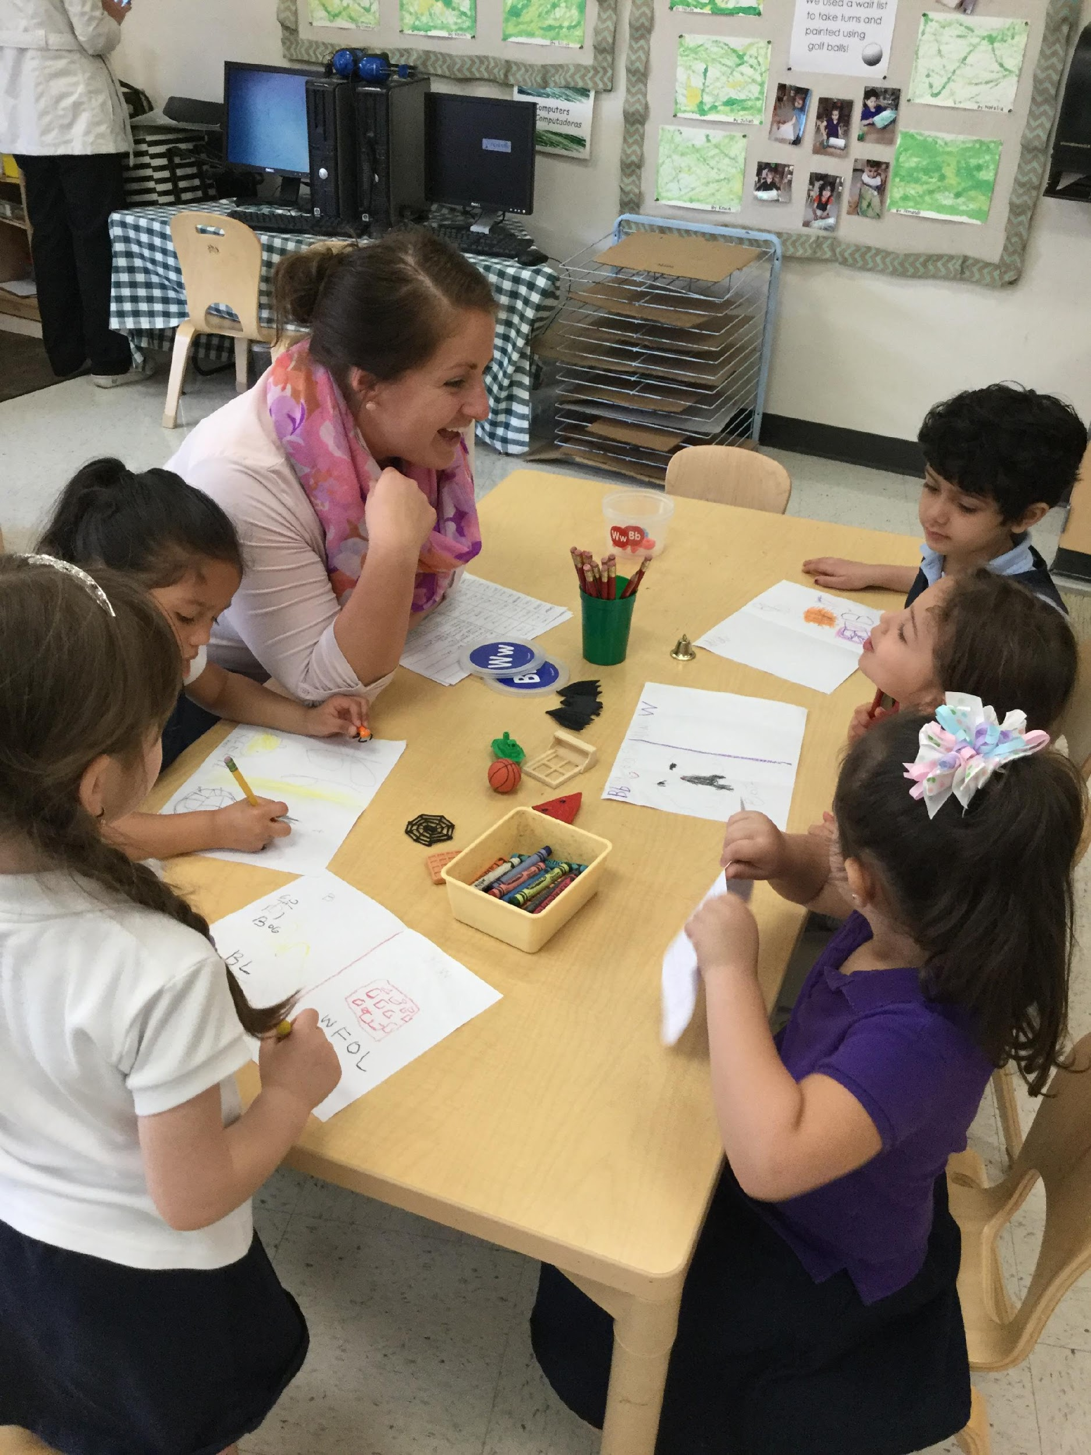
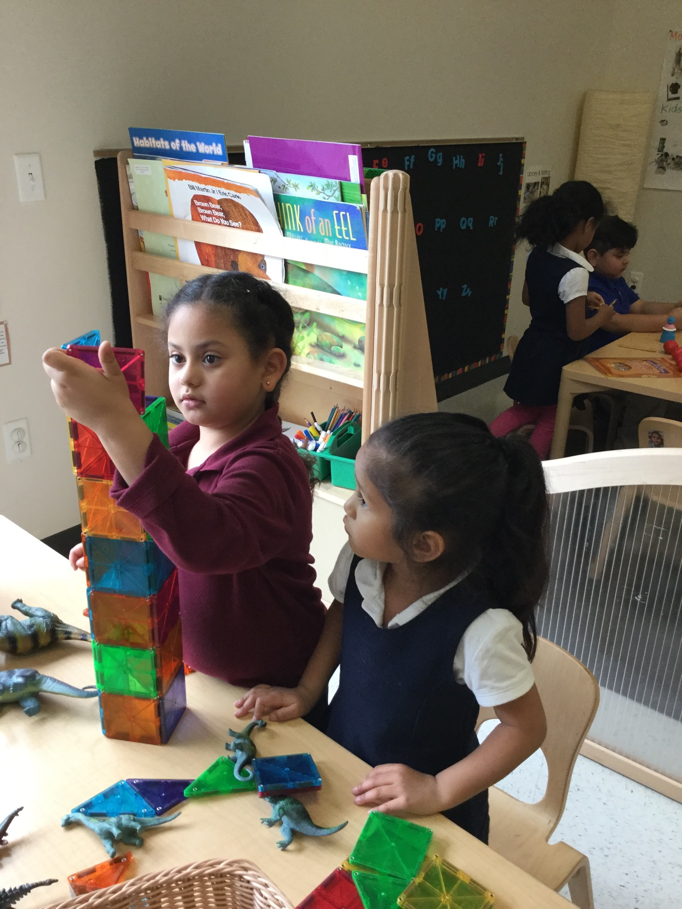
Promoting High Levels of Engagement in Learning
CHALK PROFESSIONAL DEVELOPMENT SERIES

Slide 2
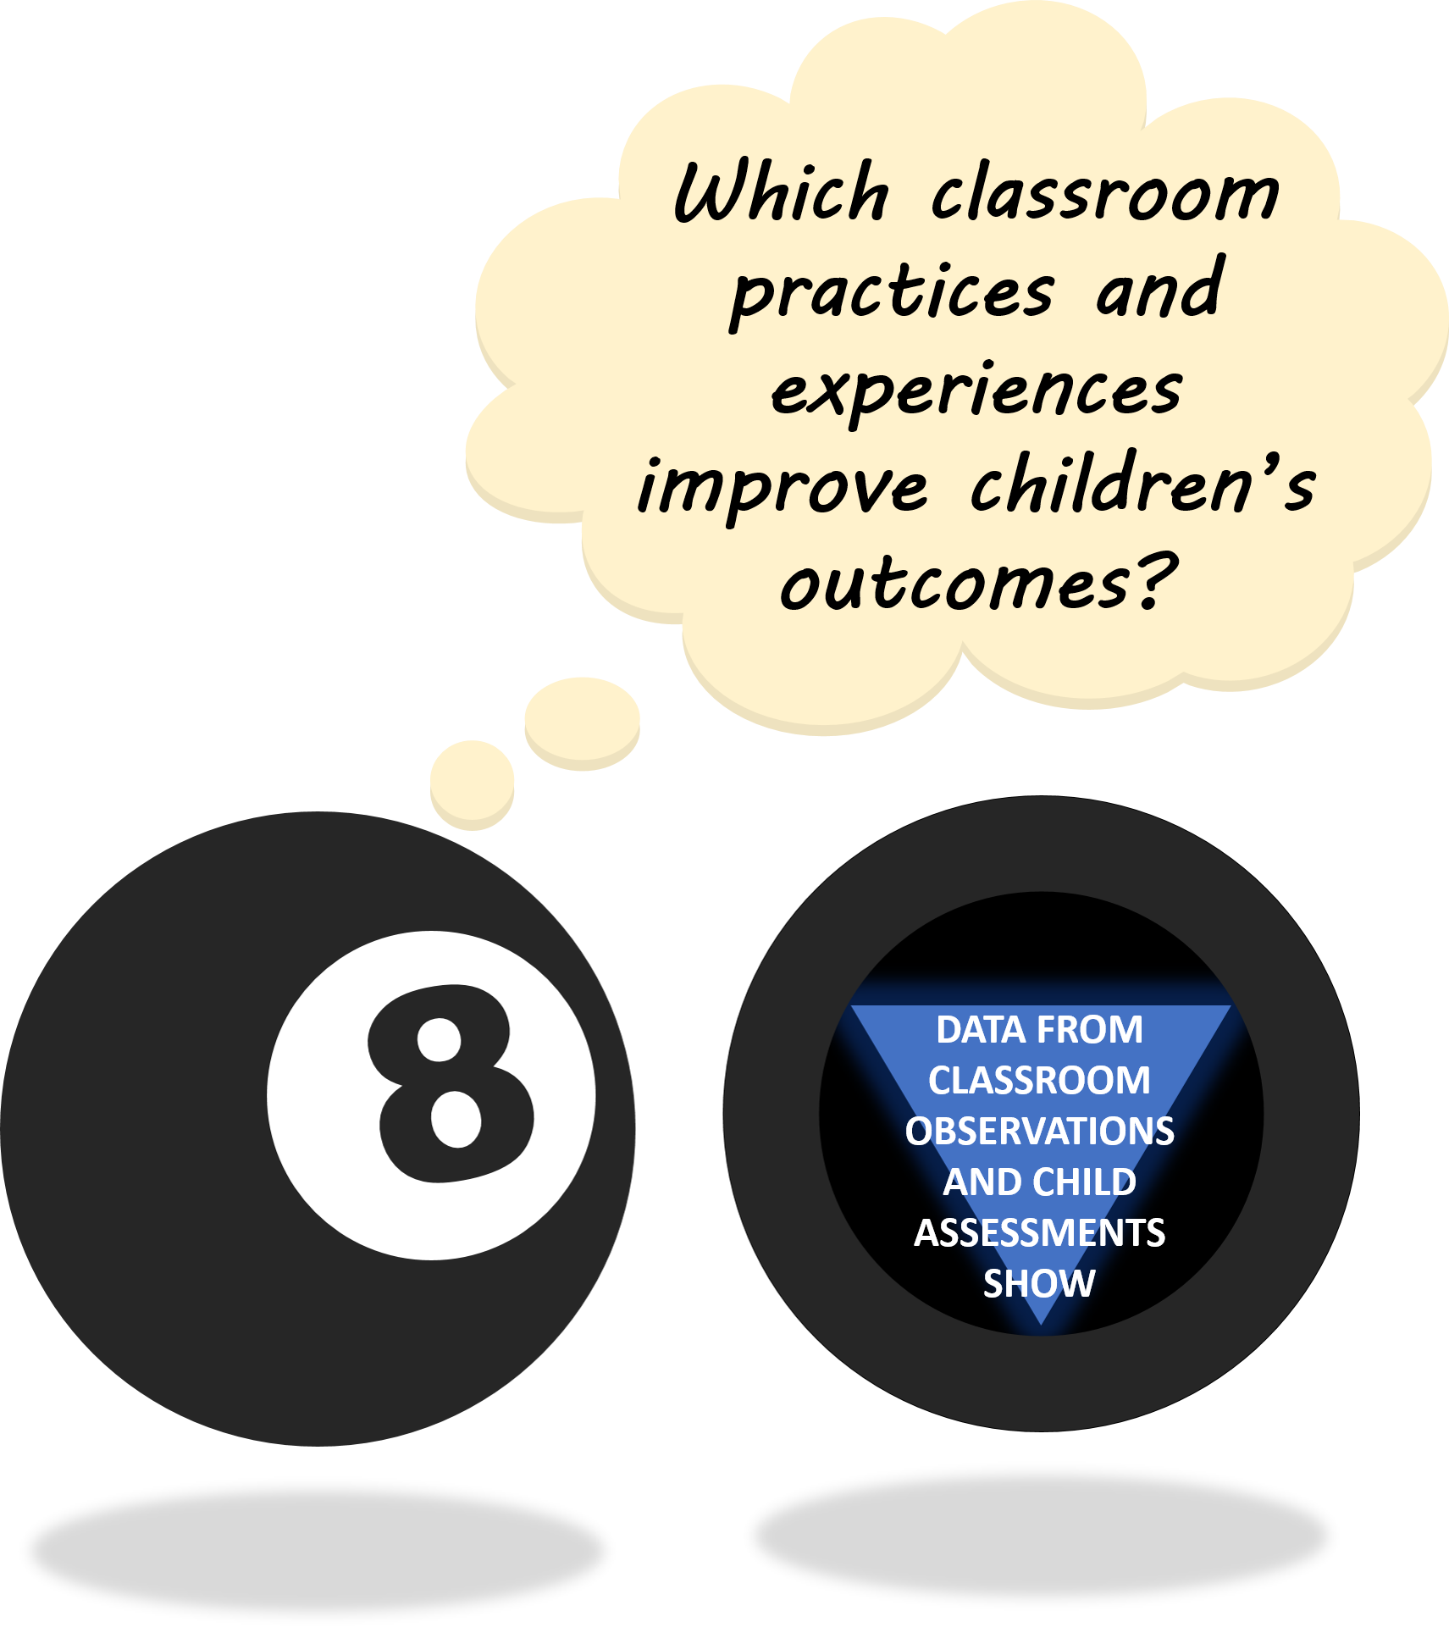
THE “MAGIC 8” CLASSROOM PRACTICES
Reduce time spent in transition
Improving level of instruction
Creating a positive climate
Increasing teacher listening to children
Planning sequential activities
Promoting associative and cooperative interactions
Fostering high levels of engagement
Providing math opportunities
★ 2017-18 Initiative: Focus on Literacy ★

Slide 3
WHAT IS ENGAGEMENT IN LEARNING?
Engagement in learning refers to one’s degree of…
Creating a positive climate
Providing math opportunities
Reducing time spent in transition
Attention
Curiosity
Interest
Motivation
Optimism
Passion
FOSTERING HIGH LEVELS OF ENGAGEMENT
…related to a learning task.
Promoting associative and cooperative interactions
Improving level of instruction
Implementing any or all of the other Magic 8 classroom practices should result in children being more engaged in learning!
Planning sequential activities
Increasing teacher listening to children
Notes:
Emphasize that higher engagement in Learning is a result of emphasizing any or all of the Magic 8 classroom practices
…include talking points on how each practice is related to engagement?

Slide 4
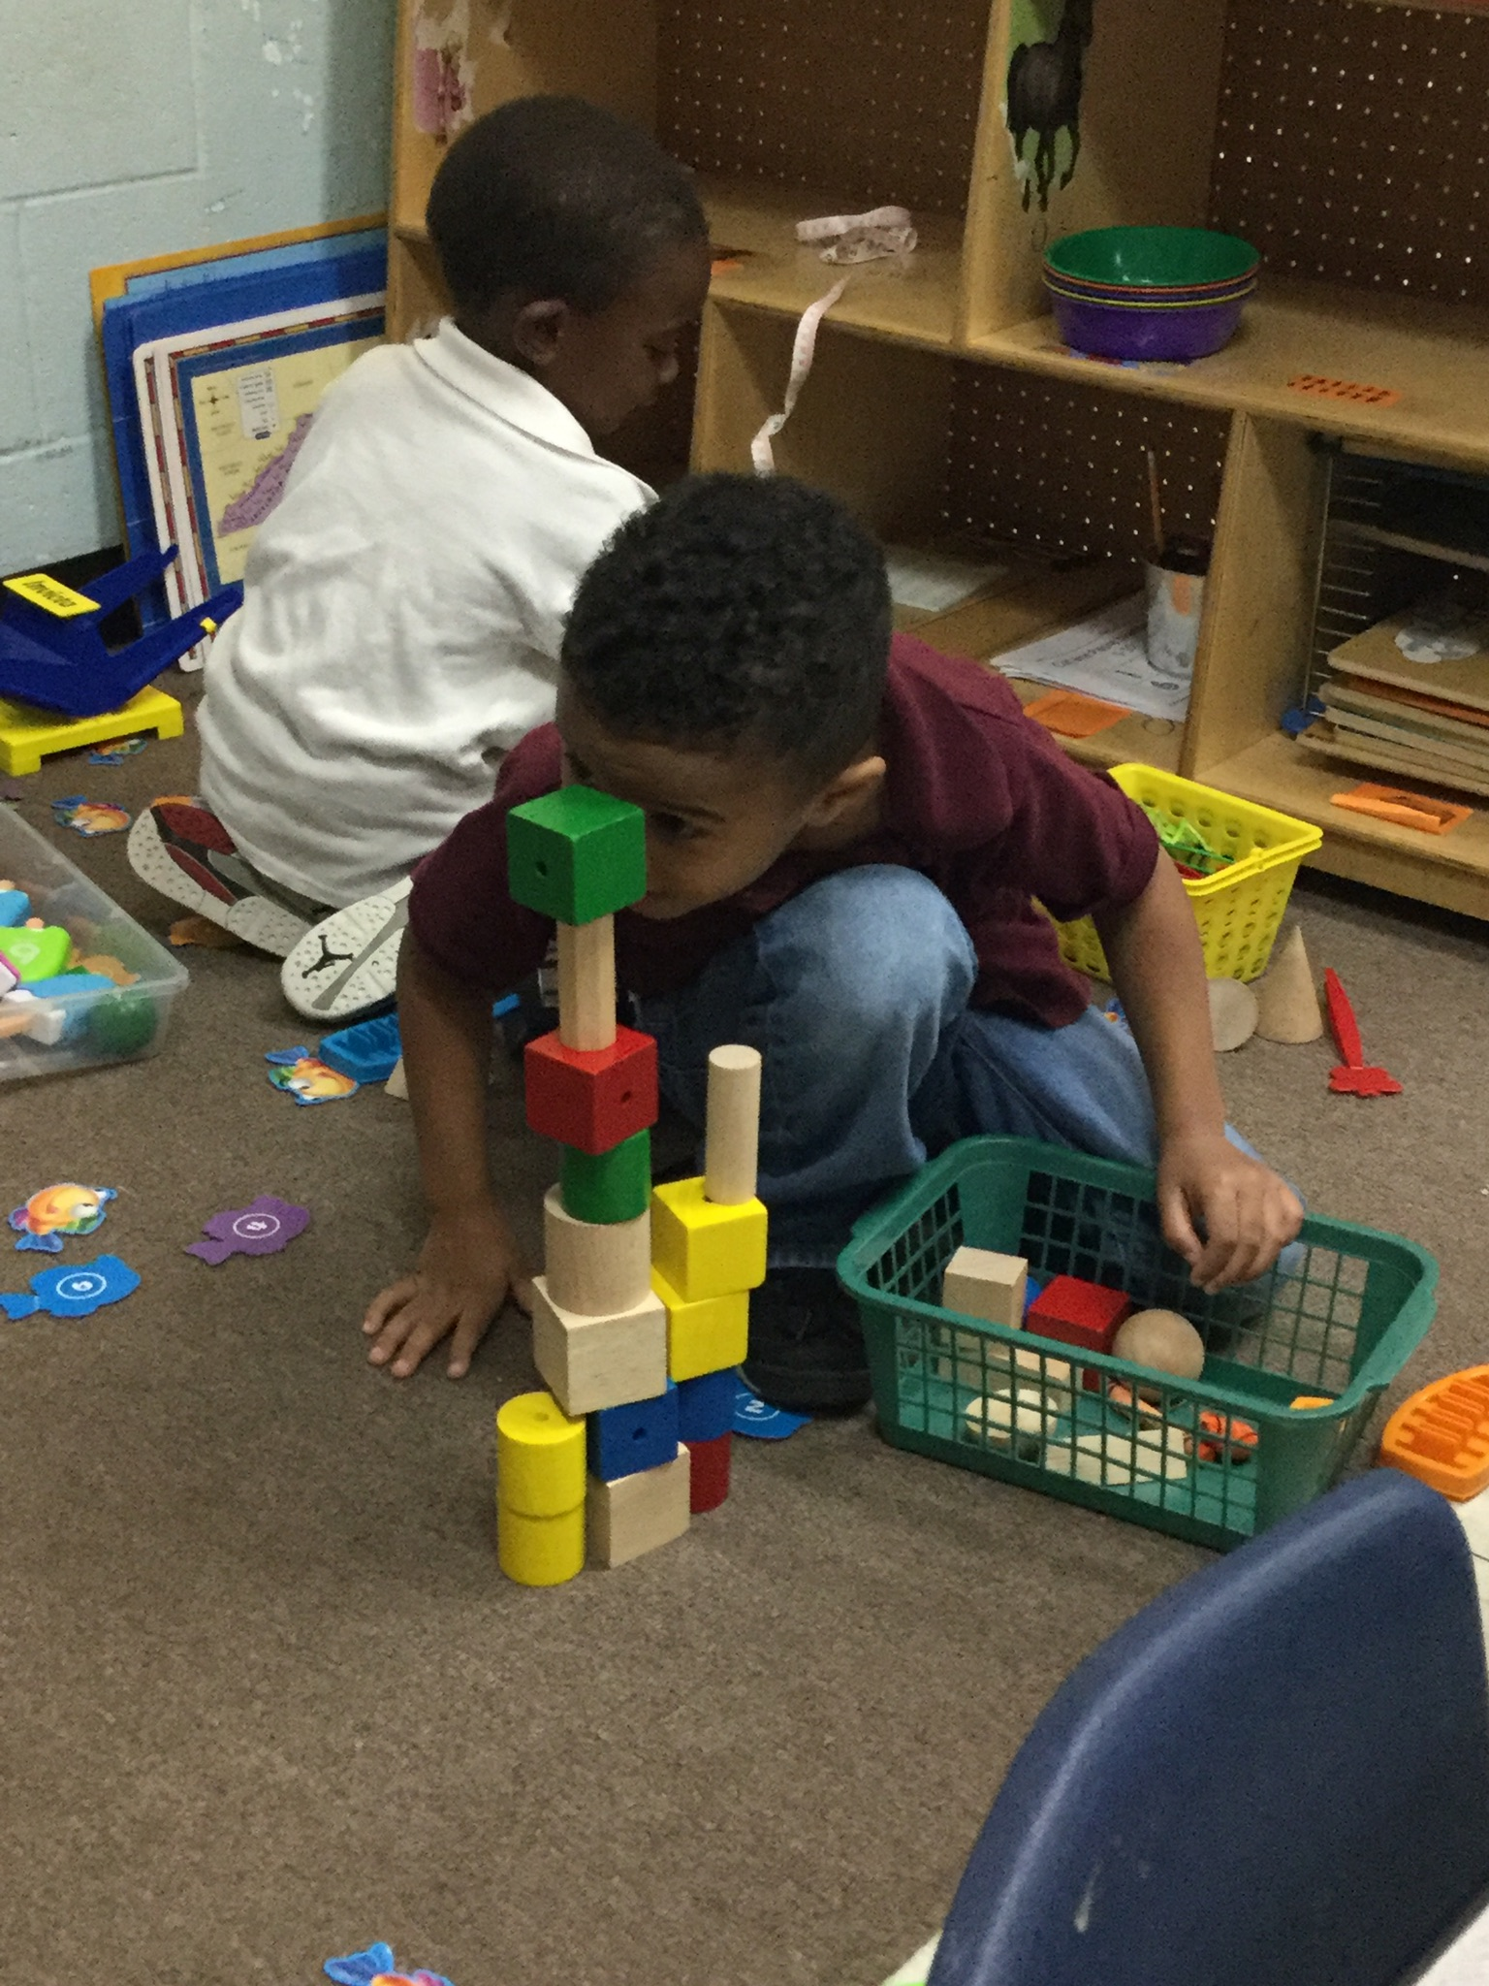

BENEFITS OF HIGH ENGAGEMENT IN LEARNING
Children who are highly engaged in learning activities…
Have more opportunities to deepen their learning
Have better self-regulation
Are less likely to engage in off-task or disruptive behaviors
These children also make greater gains in…
Narrative comprehension
Vocabulary
Math skills
Being deeply engaged in preschool fosters a love of learning and discovery that will serve children for years to come.
DISCUSSION POINT:
Why do we see such positive outcomes when children are deeply engaged in learning?

Slide 5

MARKERS OF HIGH ENGAGEMENT IN LEARNING
Individual children express their enthusiasm (or lack thereof) in different ways…
Persistence & intense concentration
Makes eye contact with teachers/peers; looks closely at materials
Seems oblivious to noise and behaviors of other children
Tension in body: leaning forward, attempting to move closer
Volunteers responses or on-topic comments (often in a raised voice)
Positive affect: laughing, smiling, gasping
Engagement may also look different depending on the setting, (Whole Group vs Centers), time of day (morning vs after nap), or activity (working on a floor puzzle vs dancing to a song).
DISCUSSION POINT:
Do you ever mistake a child’s enthusiasm for disruptive behavior?
Notes:
With these indicators in mind, what are some activities or settings where you find your students to be the MOST engaged?
I
nclude descriptions with each marker? Examples by setting? Coaches want slides to contain more/different information than handouts…
Could add more description to each of these markers…
Other discussion questions:
How might engagement look different during Whole Group or Centers?
Think of the times when your students are the most engaged…what factors do you think contribute to their engagement?
Compliant =/= engaged
**a.k.a., “calling out”
Compare ‘fidgeting’ with excited energy

Slide 6

MARKERS OF LOW ENGAGEMENT IN LEARNING
Individual children express their enthusiasm (or lack thereof) in different ways…
Lack of persistence
Looks at teacher or materials inconsistently or stares into space
Easily distracted or drawn off task by others
Lack of tension in body: slouched, head on hand
Fidgets
Flat affect: stares into space
Draws others off task or engages in problem behaviors
It is important for teachers to be able to gauge children’s engagement level—and to have strategies for re-engaging young learners when their attention is waning.
What do you do when you realize you are losing children’s attention during an activity?
DISCUSSION POINT:
Are you satisfied as long as children are quiet/compliant, or do you actively strive for excitement/engagement?
Notes:
NOTICING LEVEL OF ENGAGEMENT
Compliant =/= engaged
**a.k.a., “calling out”
Compare ‘fidgeting’ with excited energy

Slide 7
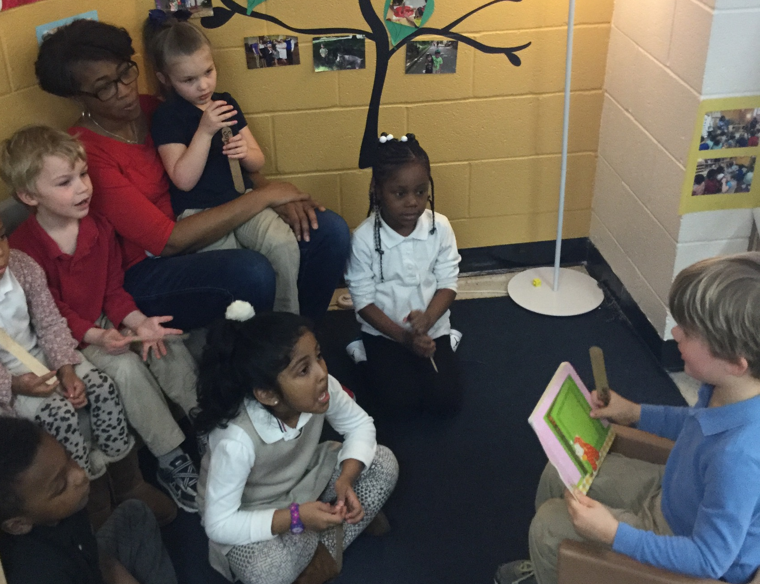
TEACHER SUPPORT FOR HIGHER LEVELS OF ENGAGEMENT
Teachers who strive for higher levels of engagement in children…
Enjoy themselves! As the teacher, your enthusiasm (or lack thereof) is contagious
Rotate materials throughout the year
Incorporate new and unusual materials
Vary the centers/interest areas available to children
Allow children to lead parts of the day
Follow children’s unique interests
Consider children’s academic and social skills when setting up learning interactions
Remain flexible when the unexpected happens
…and, most importantly:
Notes:
Of the strategies listed, which ones to you think are your strengths? What would you like to improve upon or learn more about?
How do you convey your enthusiasm to students? Do you find it challenging to maintain that level of enthusiasm all year long?

Slide 8
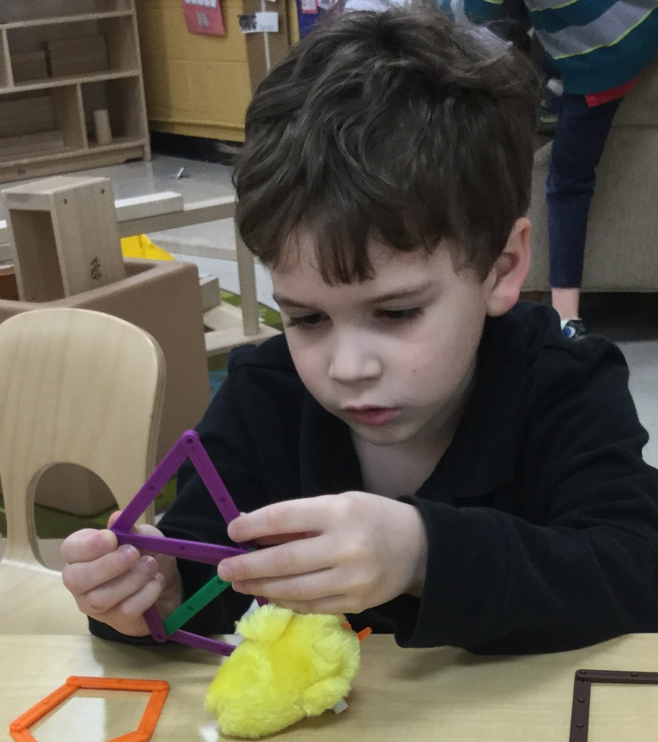
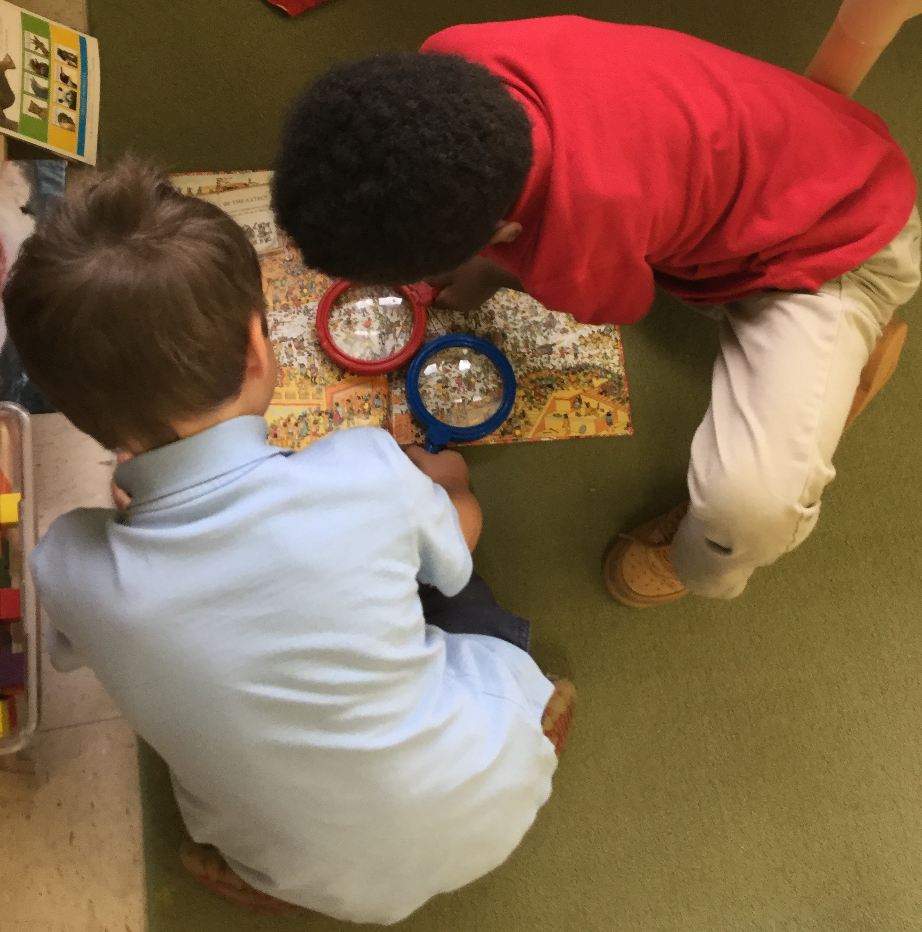
ACTIVITIES & SPACES THAT PROMOTE HIGHER LEVELS OF ENGAGEMENT
Activities that lead to higher levels of engagement…
Allow children to pursue their interests
Encourage associative interactions with other children and/or adults
Occur in a smaller-group format
Are self-correcting in nature so children can learn independently without stopping to ask for help
What are some activities or settings where you find your students to be the MOST engaged? Do these activities or settings have other elements in common?
Notes:
Include factors/reflection slide
Choice/autonomy; validate interests
What causes low vs high engagement?
Incorporate elements of centers into more structured parts of day
Take advantage of engagement during centers; use as time to observe play, target concepts, etc.

Slide 9

SPECIAL THANKS & ADDITIONAL RESOURCES
We are grateful to the following MNPS Pre-K Instructional Coaches and Multi-Classroom Leaders for their invaluable feedback in developing these materials:
SeTara DeThrow
Carrie Head
Susan McClain
Stephanie Mullins
Holly Stone
Ashley Aldridge Wilson
Rhiannon Wilson
https://my.vanderbilt.edu/mnpspartnership/

Slide 10
INDIVIDUAL IMAGE SOURCES
FREQUENTLY USED IMAGES*
ADDITIONAL IMAGE SOURCES
Lightbulb | myiconfinder.com
Designed by Vexels.com:
Hand drawn magnifying glass
Hand drawn bar graph
Pie chart hand drawn doodle
Hand drawn wall clock
Hand drawn cloud bubble
Hand drawn open book
Cog wheel hand drawn icon
Slide 5: big eyes | pixabay.com
Slide 6: bored book | pixabay.com
*These graphics are used as icons throughout the series. For example this lightbulb clipart appears beside most “Discussion Point” questions.

